Slide 1
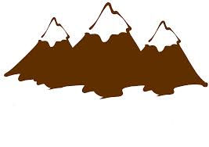
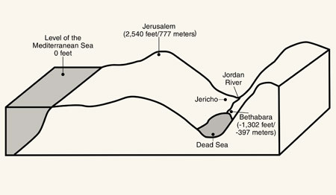
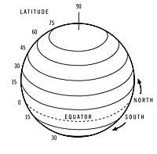
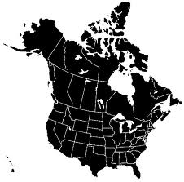
Factors that Affect Climate Legend
MOUNTAIN RANGES
OCEAN CURRENTS
LAND ELEVATION
LATITUDE
LAND MASSES
LARGE BODY OF WATER
PREVAILING WINDS

Slide 2
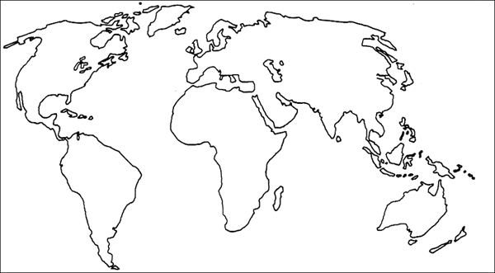
Location: Windsor, ON
P
P
P
P

Slide 3
Location: Windsor, ON
T
T
T
VARIES

Slide 4
1. LATITUDE
As latitude INCREASES, the average daily temperature DECREASES
Latitude increases towards the North and South Poles, it is 0 (zero) at the equator
The temperature gets colder toward the poles.

Slide 5
LATITUDE (continued)
Belts of low pressure at 0◦ and 60◦ N and S latitudes produce heavy precipitation
Belts of high pressure centered at 30◦ N and S produce dry climates, even deserts

Slide 6
2. LARGE LANDMASSES
Near the center large landmasses have:
wider ranges in Temperature, both between day and night and seasonally
Tend to have dry climates

Slide 7
3. LARGE BODIES OF WATER
There is a moderating effect on the temperature of coastal areas:
Low ranges in temperature, both between day and night and seasonally
Higher than average precipitation

Slide 8
4.MOUNTAIN RANGES
Windward sides are cooled, while leeward sides are warmed.
Windward sides of mountains tend to receive higher than average precipitation; leeward side tend to receive lower than average precipitation

Slide 9
5.ELEVATION
As elevation increases, the average yearly temperature decreases

Slide 10
0
6.PREVAILING WINDS
Wind direction determines the windward and leeward sides of both mountain ranges and large bodies of water

Slide 11
7. OCEAN CURRENTS
Currents tend to warm temperature of eastern coastal areas and cool temperatures of western coastal areas

